Slide 1


Atopeperdios.com
Adidas tech sportS:
“data collection optimization in real time”

Slide 2
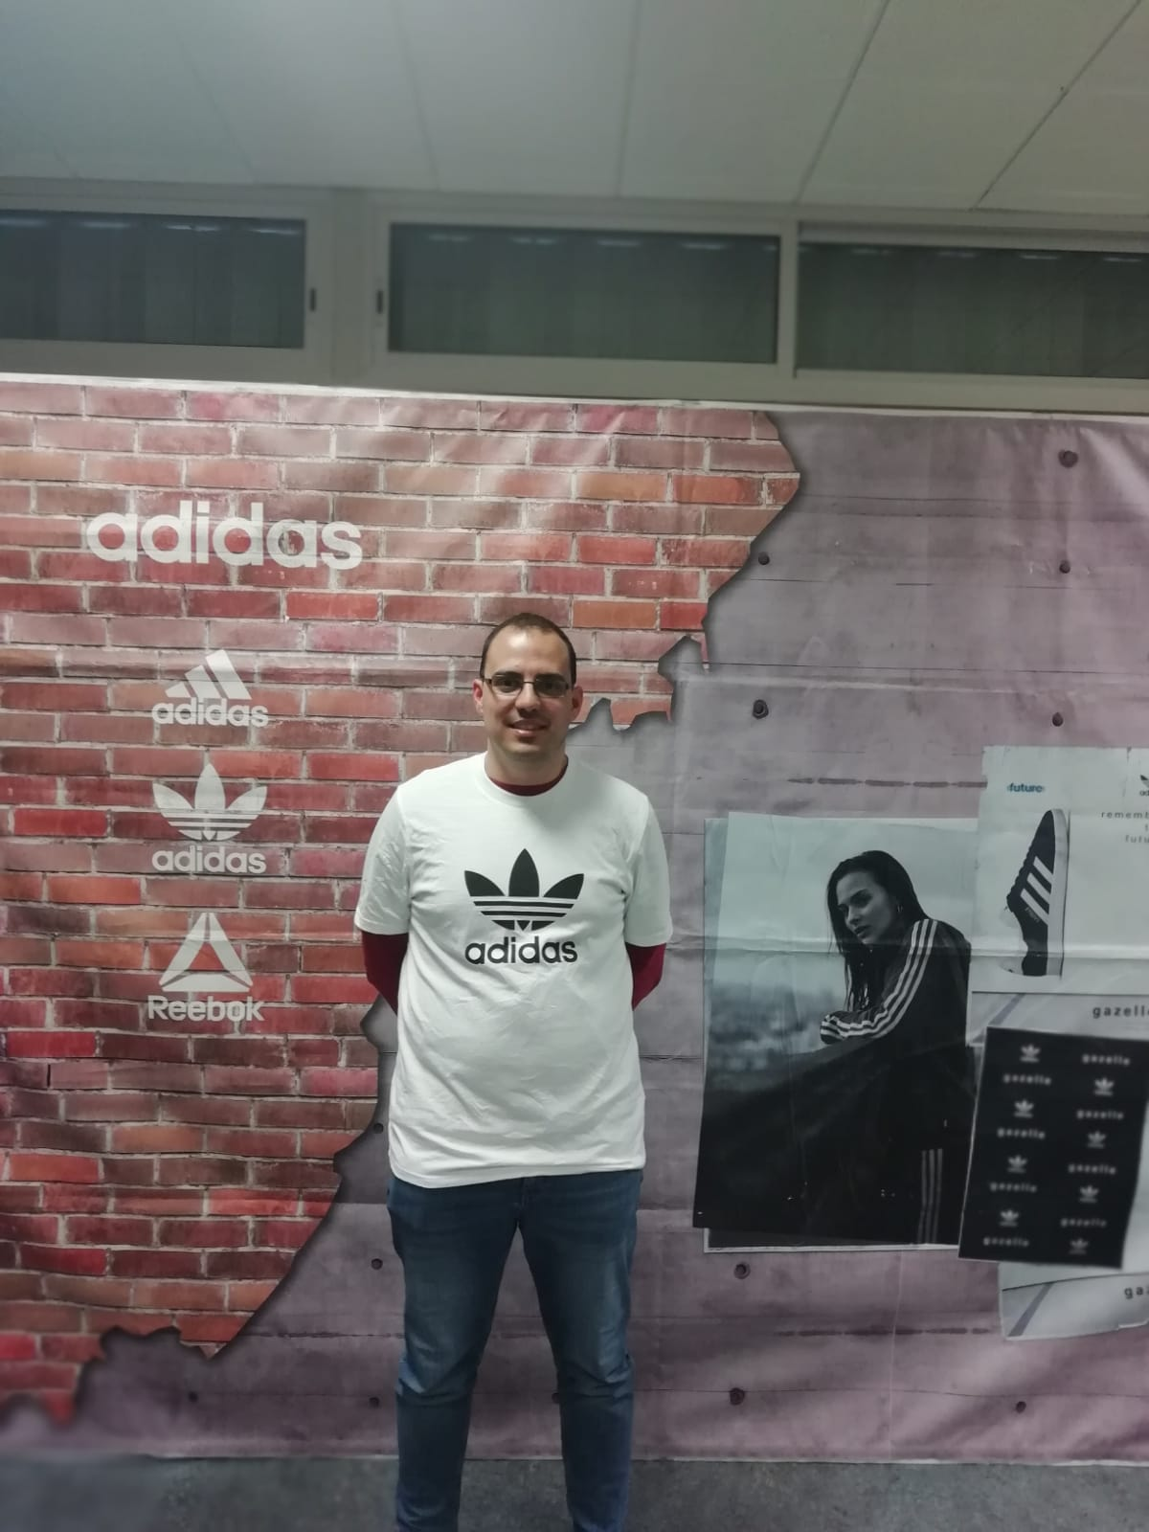
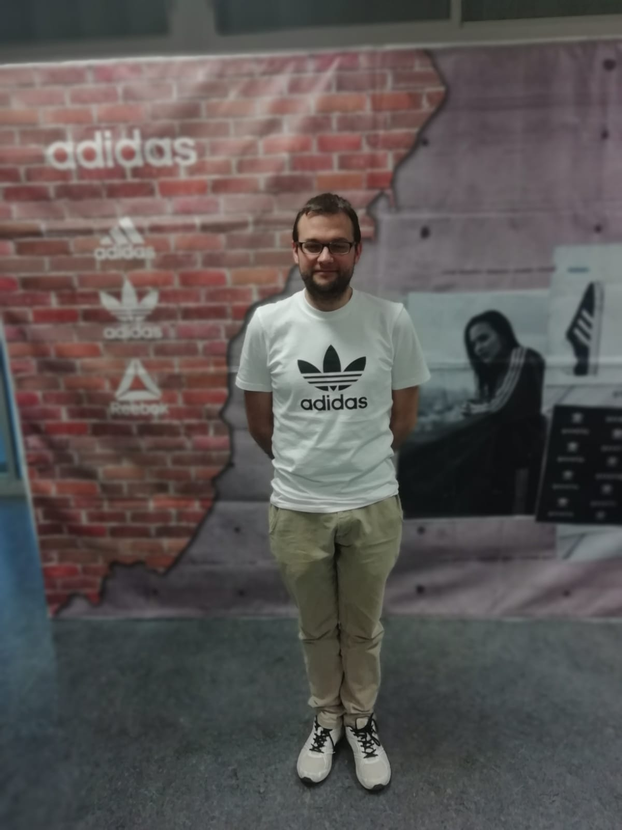
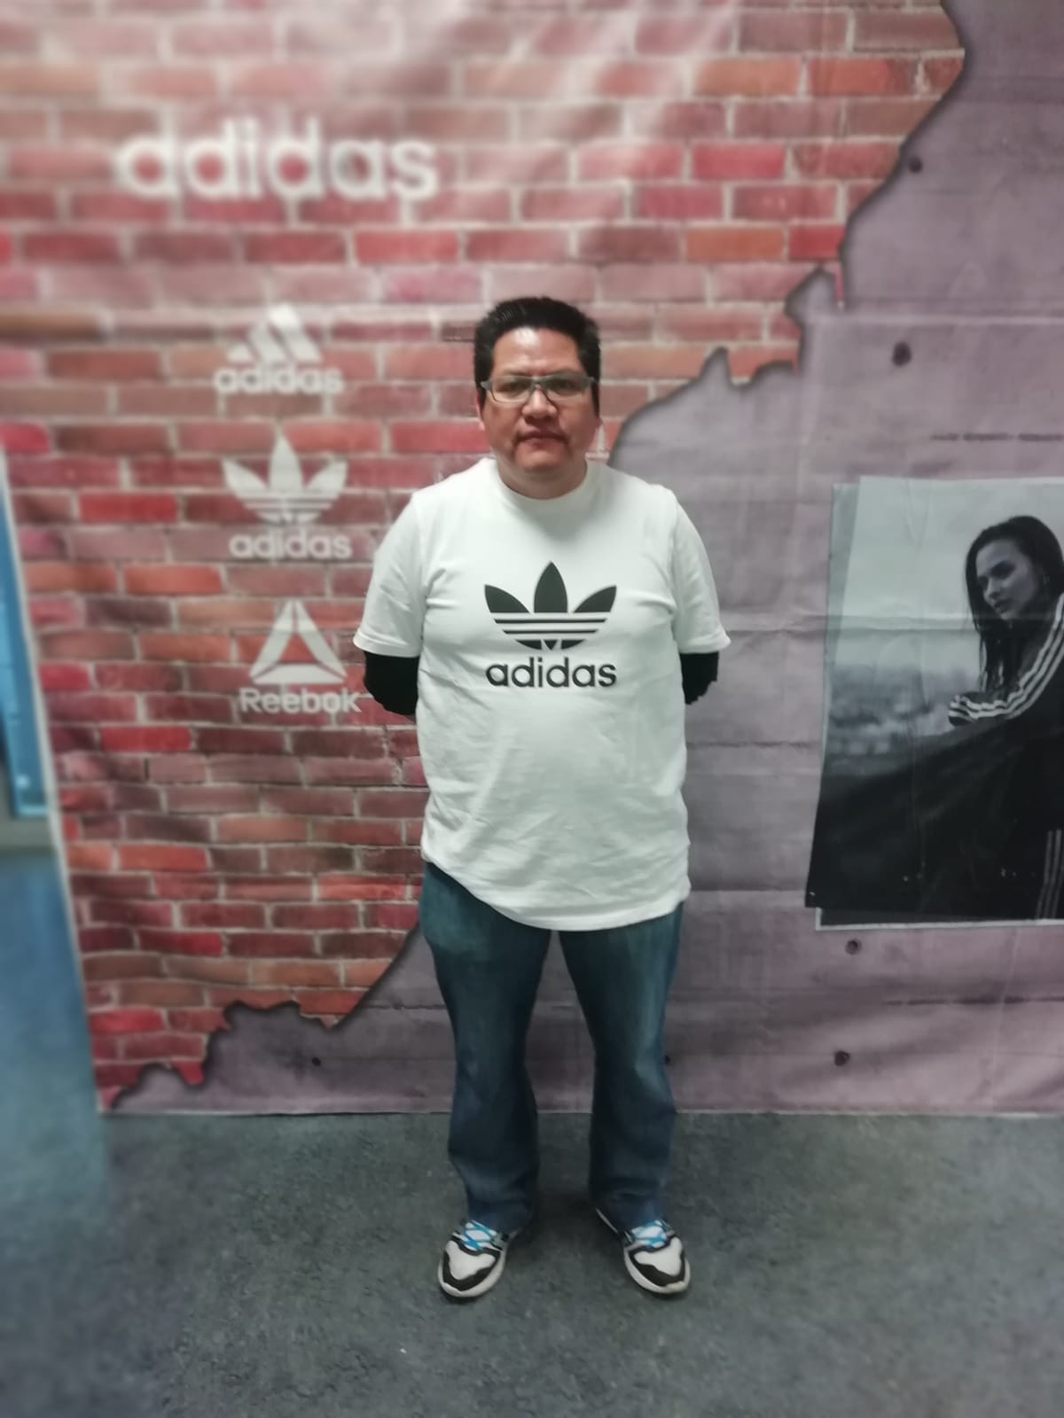
Team members
Jose manuel naveiro gomez
MASTER DEGREE / MECHANICAL ENGINEER
Pau urdeitx diaz
MASTER DEGREE / MECHANICAL ENGINEER
Andres hidalgo morales
MASTER DEGREE / MECHANICAL ENGINEER

Slide 3

AGENDA
THE STORY
FOCUS
VALUE
DEMO
Q&A

Slide 4
THE STORY - MAKE IT RELATABLE
Introduction – What is the setting
Rising Action – What is happening
Turning point – Where does it become actionable
Falling Action – What is the outcome
Resolution – How it ends

Slide 5
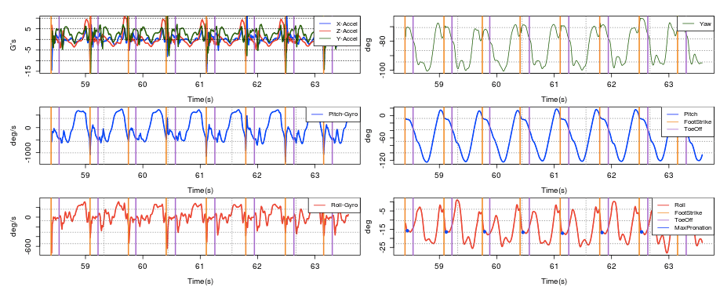
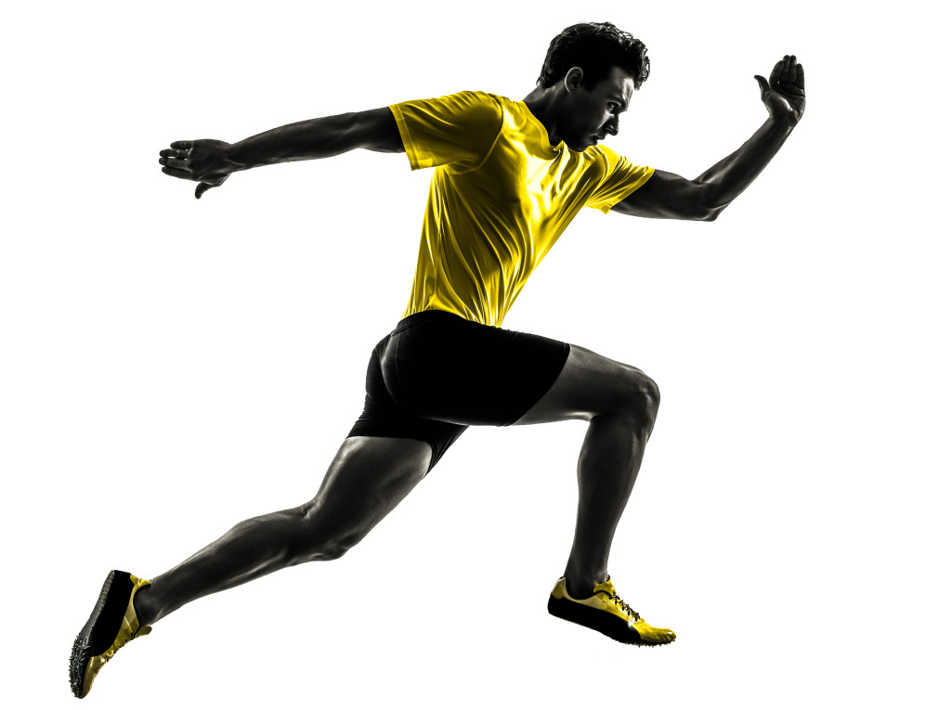
Introduction
Real-time data collection

Slide 6
Rising Action
The data and the information, through a wireless device with an advanced GPS system, to a signal receiver that captures the data in a computer.
The screen with data and variables related to the game and statistics, which come directly from the player himself.

Slide 7
Turning point
Algorithms aggregate players' stats and display them in real-time.
Normally the easiest way to sync is by pressing and holding the BACK button on your training device.
Or hit the sensor to activate.

Slide 8
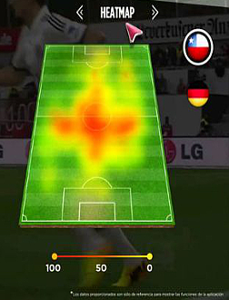
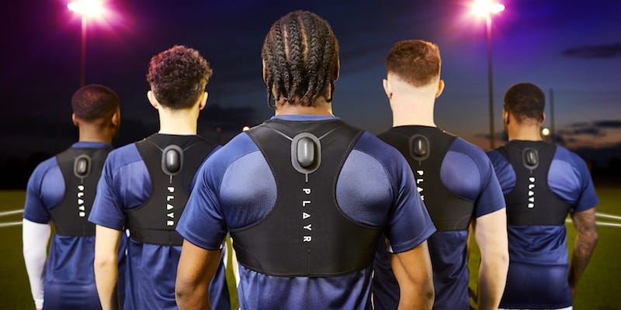
Falling Action
Simultaneous activation
Data processing optimization
Automation Synchronization

Slide 9
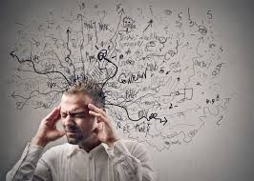
WHY DOES IT MATTER?
“I want to hear everything that happens in a game but there is no time to analyze all the data”

Slide 10

WHO DOES IT IMPACT?
“ Extract only valuable information, that with which we can make decisions based on representative data ”

Slide 11
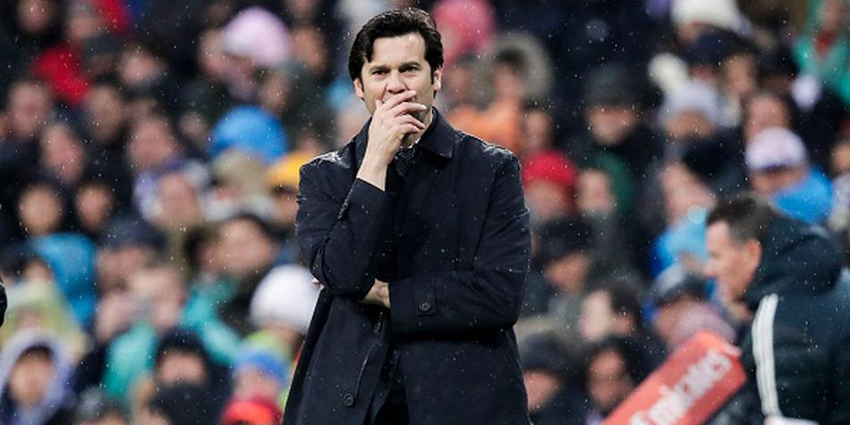
WHERE IS THE BUSINESS OPORTUNITY?
Early decision making can influence whether you lose or win

Slide 12
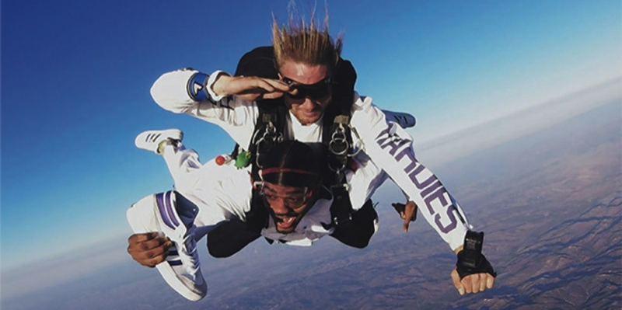
MAKE IT REAL
DEMO

Slide 13
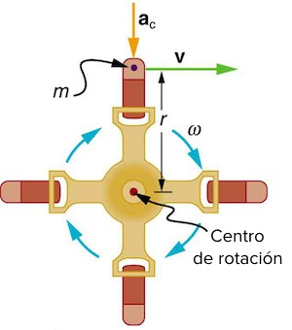
CONCEPT THEORY
Angular velocity:
- Constant
- Known
-Single direction
We know moment and shape of the exact curve of the sensor

Slide 14

Q
A
&

Slide 15
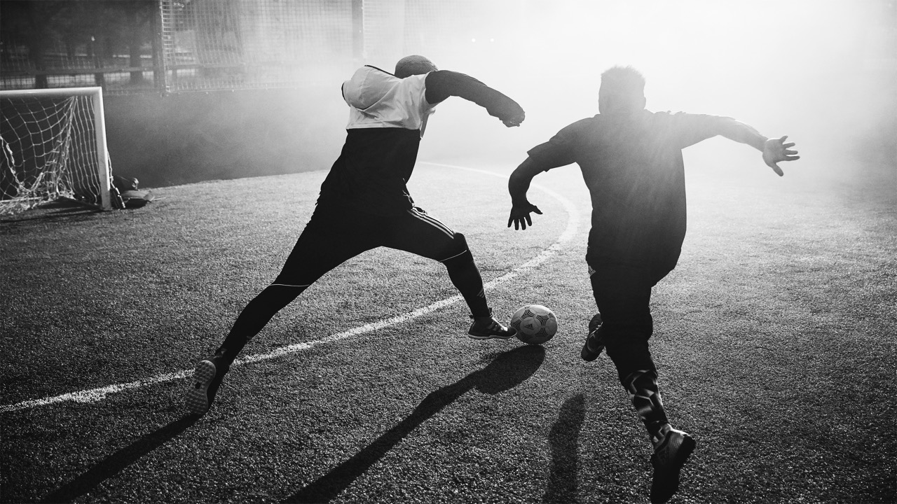
THANK YOU!

